Slide 1
Fake AD Click Detection
Gautam Shanbhag
(18210455)
Supervisor : Mark roantree
Dublin City University

Slide 2


AD World
https://blog.bannersnack.com/mobile-ads/
https://charlesngo.com/beginners-guide-native-advertising-for-affiliate-marketing/

Slide 3

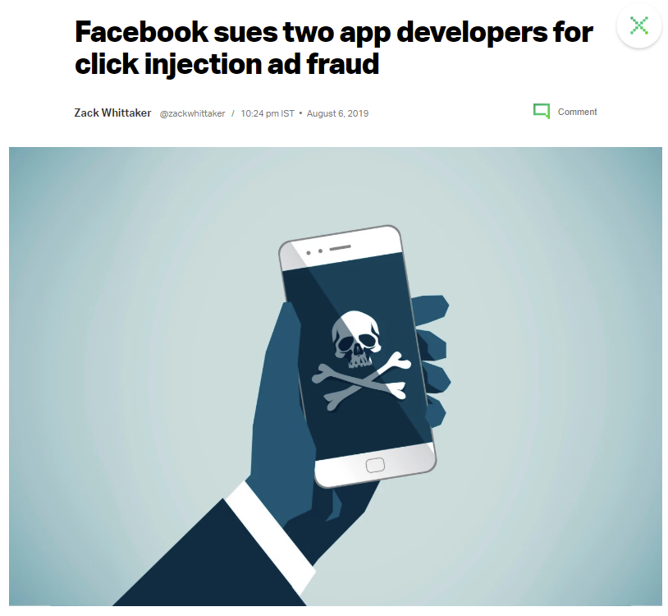
Introduction
https://www.retaildive.com/news/mobile-ad-fraud-rates-double-with-shopping-apps-hardest-hit/523240/
https://techcrunch.com/2019/08/06/facebook-clickjacking-ad-fraud-suit/

Slide 4
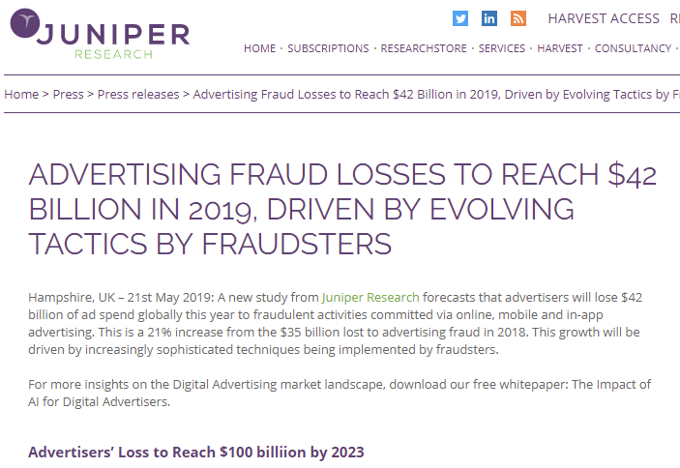
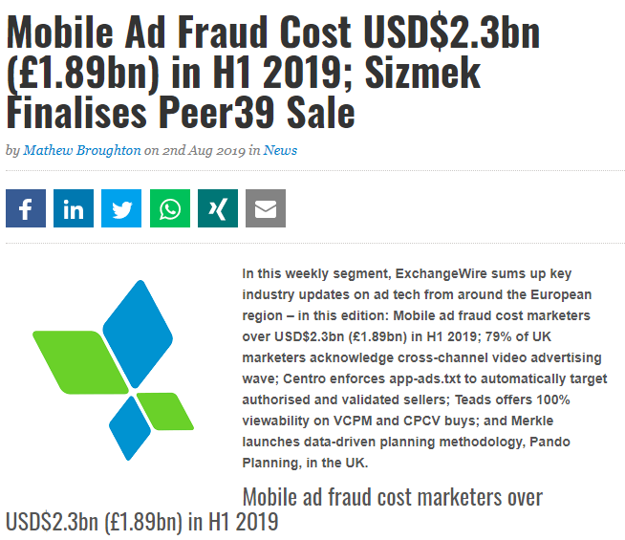
https://www.juniperresearch.com/press/press-releases/advertising-fraud-losses-to-reach-42-billion
https://www.exchangewire.com/blog/2019/08/02/mobile-ad-fraud-cost-usd2-3bn-1-89bn-in-h1-2019-sizmek-finalises-peer39-sale/

Slide 5
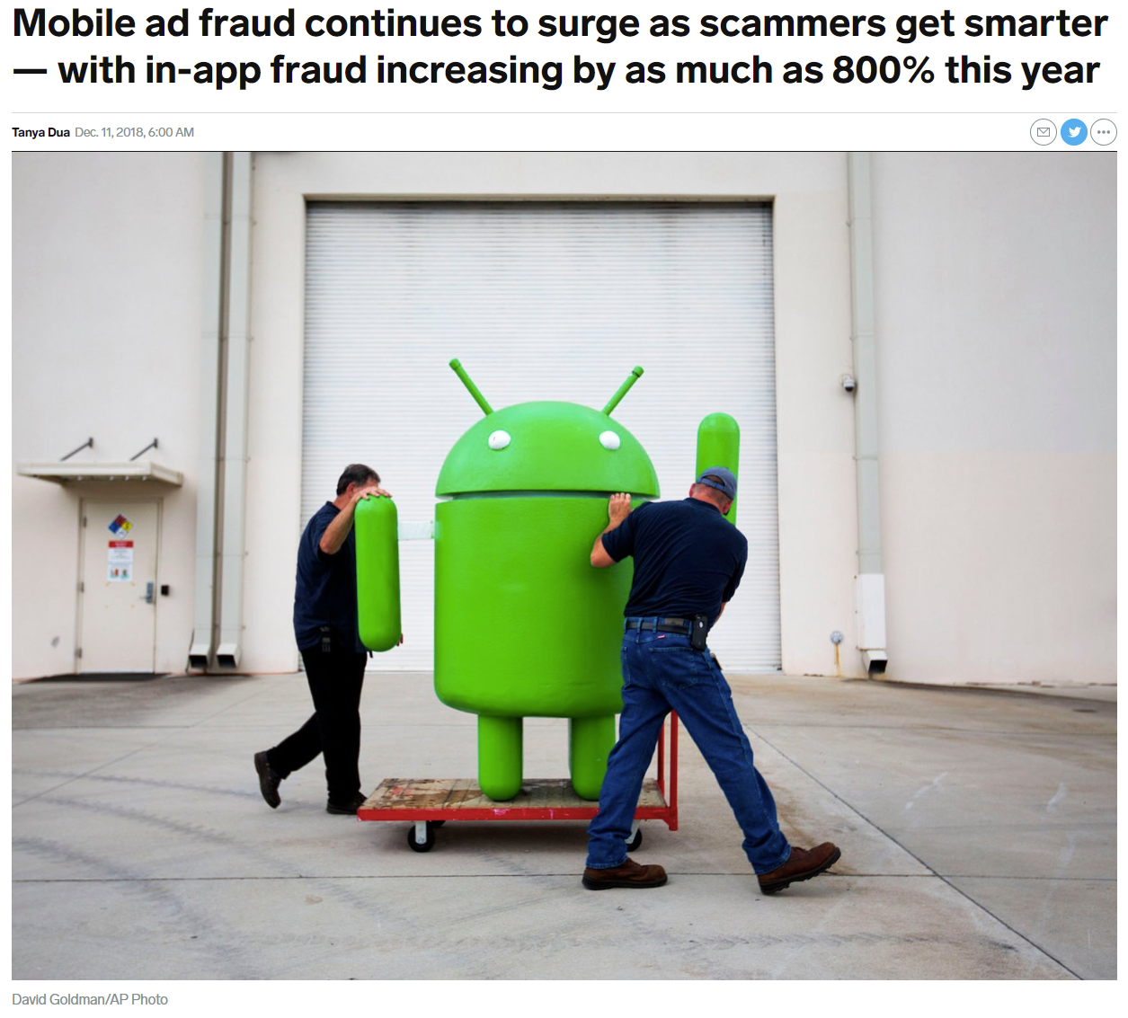
PAY PER CLICK
Whenever an ad displayed by a search engine is clicked, the advertiser pays a small fee for each click.
Most often, the link directs the potential buyer to advertiser’s website
INVALID CLICKS
Advertisers should not pay for
Non-malicious clicks
Clicks from spiders indexing sites
Human or bot clicks for testing ad campaign
Clicks from outside geo-targeted region
https://www.businessinsider.com/mobile-ad-fraud-surges-with-in-app-fraud-increasing-by-800-in-2018-2018-12?r=US&IR=T

Slide 6
Click fraud is a black-hat technique of falsely inflating the number of clicks on a pay-per-click ad.
Advertisers are trying to sabotage their competitors by driving up their costs and meeting their budget caps early on in the day
Ad publishers are clicking on the ads displayed on their own sites to generate more revenue for themselves.
WHY
Generate Revenue and profit for themselves
Hurt a competitor by depleting their ad budget and improving their own adposition
Weaken companies by driving up their marketing cost or increase cost of acquisition

Slide 7
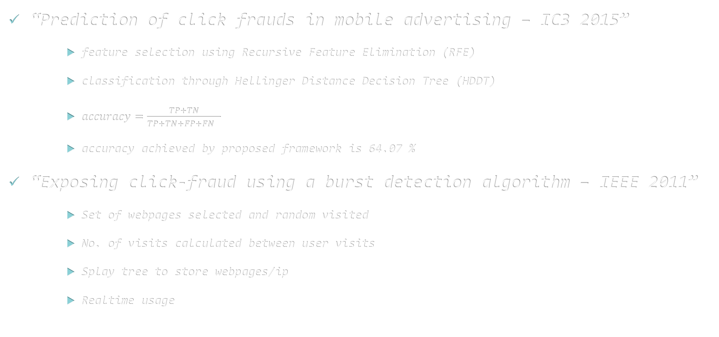
Previous Work
“Prediction of click frauds in mobile advertising – IC3 2015”
feature selection using Recursive Feature Elimination (RFE)
classification through Hellinger Distance Decision Tree (HDDT)
$accuracy=\frac{TP+TN}{TP+TN+FP+FN }$
accuracy achieved by proposed framework is 64.07 %
“Exposing click-fraud using a burst detection algorithm – IEEE 2011”
Set of webpages selected and random visited
No. of visits calculated between user visits
Splay tree to store webpages/ip
Realtime usage

Slide 8
Previous Work
“Real Time Click Fraud Prevention using multi-level Data Fusion – WCECS 2010”
Dempster-Shafer evidence theory
multi level data fusion mechanism
“Detecting insurance claims fraud using machine learning techniques – ICCPT 2017”
“Machine learning algorithms for document clustering and fraud detection – ICDSE 2016”

Slide 9
Dataset Description
Source : LARC SMU-CMU Singapore Management University provided by BuzzCity
R. J. Oentaryo, E.-P. Lim, M. Finegold, D. Lo, F.-D. Zhu, C. Phua, E.-Y. Cheu, G.-E. Yap, K. Sim, M. N. Nguyen, K. Perera, B. Neupane, M. Faisal, Z.-Y. Aung, W. L. Woon, W. Chen, D. Patel, and D. Berrar, "Detecting click fraud in online advertising: A data mining approach," Journal of Machine Learning Research, vol. 15, pp. 99-140, 2014.

Slide 10
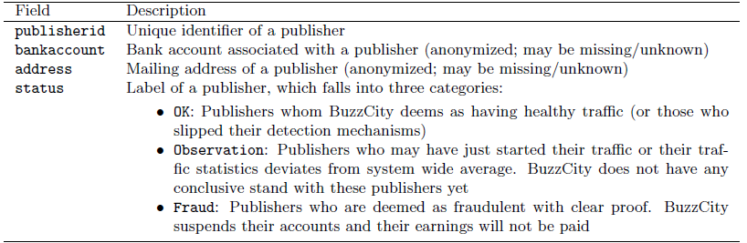
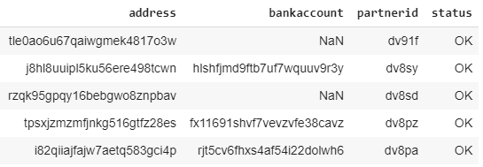
Dataset Description

Slide 11
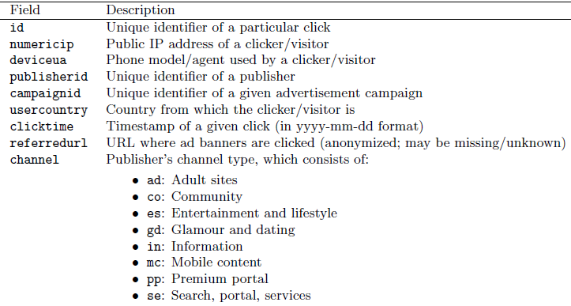
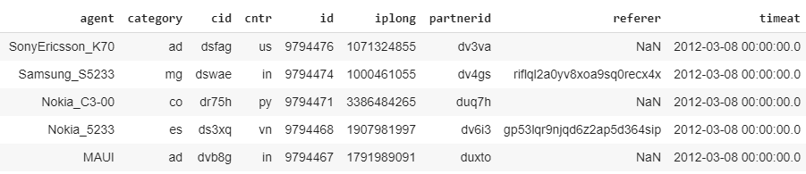
Dataset Description

Slide 12
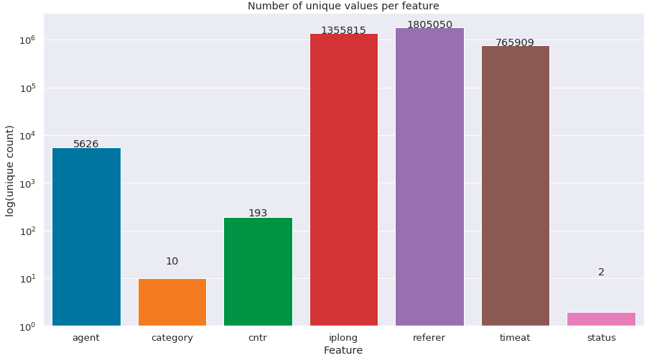
More About Data
SIZE : 69,38,523 ie 7 million
‘Fraud’ – 4,44,439
and
‘OK’ – 64,94,084

Slide 13
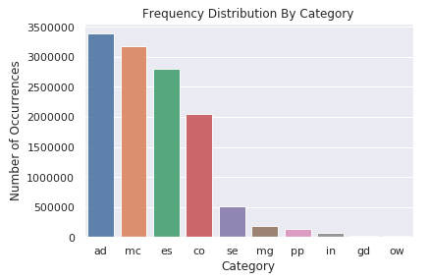
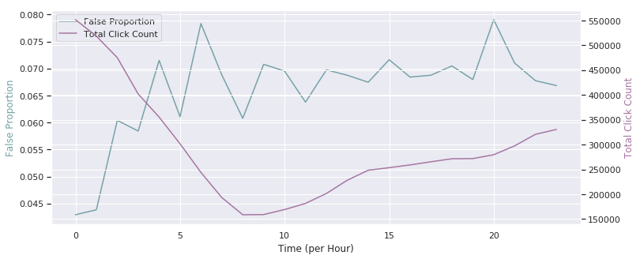
Understanding Data
Figure 3 : Hourly Fraud Ratio to Total Click count

Slide 14
Feature Extraction
Curse of Dimensionality
One Hot Encoding
Encoding Categorical Features [Online]. Available : https://towardsdatascience.com/encoding-categorical-features-21a2651a065c
The Curse of Dimensionality [Online]. Available : https://towardsdatascience.com/the-curse-of-dimensionality-50dc6e49aa1e

Slide 15
Feature Extraction
Sr. No. | Type Of Features | Features Extracted
1 | Time Features : | click_month
 |  | click_day
 |  | click_hour
 |  | click_min
 |  | click_sec
2 | Count Features : | clicks_by_ip
 |  | clicks_by_cntr
 |  | clicks_by_referer
 |  | clicks_by_category
 |  | clicks_by_agent
3 | Count feature By time : | clicks_per_minute
 |  | clicks_per_hour
4 | Count feature By Grouping : | ip_ref_cat_per_min
 |  | ip_ref_cat_per_hr
 |  | ip_cat_per_min
 |  | ip_cat_per_hr
 |  | ip_min_count
 |  | agent_ip_count
 |  | agent_cntr_count
5 | Avg feature By Grouping : | ip_min_avg
 |  | ip_ref_cat_min_avg
 |  | ip_cat_min_avg
Encoding Categorical Features [Online]. Available : https://towardsdatascience.com/encoding-categorical-features-21a2651a065c
The Curse of Dimensionality [Online]. Available : https://towardsdatascience.com/the-curse-of-dimensionality-50dc6e49aa1e

Slide 16
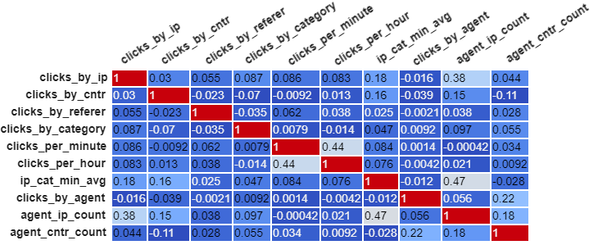
Pre Processing
Recursive Feature Elimination on Decision Tree Classifier
UnderSampling after train test split due to volume of data

Slide 17
Pre Processing
Scaling : Min-Max Scaler between 0-1

Slide 18
Algorithms
CatBoost
gradient boosting on decision trees library with categorical features support
Logistic Regression
ADA Boost with Decision Tree Classifier
Random Forest Classifier

Slide 19
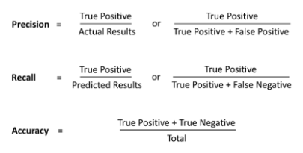
Evaluation
Algorithm | Recall | Precision | Accuracy | AUC-ROC
Random Forest | 94 | 54 | 94.44 | 94.14
CatBoost | 88 | 57 | 95.04 | 91.84
ADA Boost + Decision Tree | 92 | 36 | 89.22 | 90.64
Logistic Regression | 65 | 12 | 66.67 | 65.95

Slide 20
Conclusion

